Slide 1


Color in CSS

Slide 2

Topics
Color name
Hex color
Rgb
Rgba
Hsl
Hsla
opacity

Slide 3

In CSS colors refer to the visual aspect of an element, such as the foreground or background color, text color, border color, etc.

Slide 4
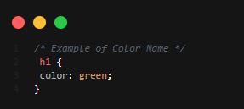
Color Name
CSS provide a set of predefined color keywords, including commonly used colors such as red, blue, green, yellow, aqua, black, and many more.

Slide 5
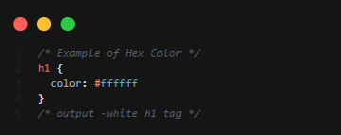
Hex Color
In CSS, hexadecimal notation (hex color) is a method of specifying color using a six-digit (0 to 255 ranging value) code that represents the amount of red, green, and blue (RGB) in a color.

Slide 6
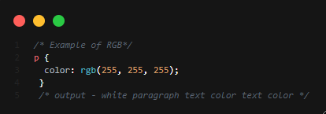
RGB
In CSS, the rgb() is a function of specifying color using values for red, green, and blue.

Slide 7
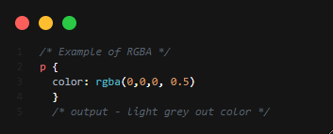
RGBA
Similar to the Rgb, The rgba() function can also be used to specify an additional alpha value for transparency. The alpha value ranges from 0 (fully transparent) to 1 (fully opaque).

Slide 8
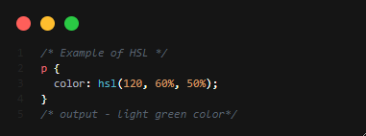
HSL
In CSS, HSL (Hue, Saturation, Lightness) is a color model that represents colors based on three values: hue, saturation, and lightness.

Slide 9
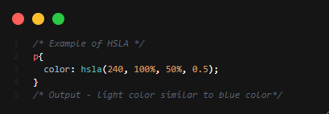
HSLA
The hsla() function can also be used to specify an additional alpha value for transparency. The alpha value ranges from 0 (fully transparent) to 1 (fully opaque).

Slide 10
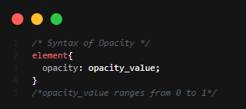
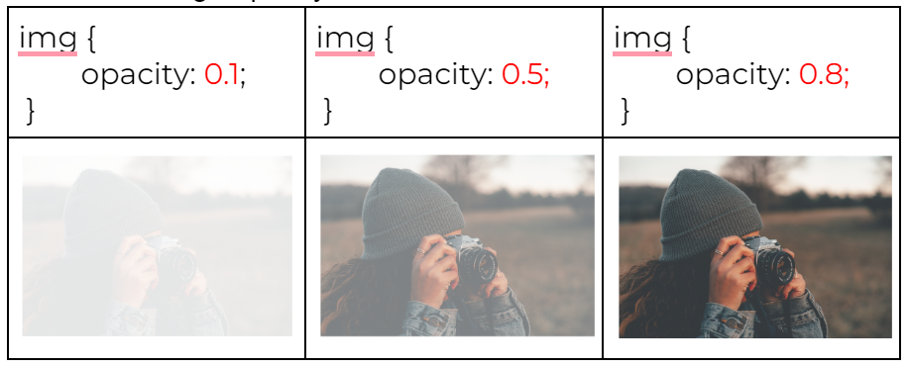
Opacity
Example illustration

Slide 11

THANK YOU

